Slide 1
Database Management System (SE-208)
LECTURE: NORMALIZATION
Course Instructor: Engr. Ruqqiya Asad

Slide 2
The Purpose of Normalization
A technique for producing a set of relations with desirable properties, given the data requirements of an enterprise.
The purpose of normalization is to identify a suitable set of relations that support the data requirements of an enterprise. The characteristics of a suitable set of relations include the following:
the minimal number of attributes necessary to support the data requirements of the enterprise;
attributes with a close logical relationship (described as functional dependency) are found in the same relation;
minimal redundancy, with each attribute represented only once, with the impor tant exception of attributes that form all or part of foreign keys, which are essential for the joining of related relations.

Slide 3
How Normalization Supports Database Design
Normalization is a formal technique that can be applied at any stage of database design.
There are two main approaches:
Approach 1 (Bottom-up): Use normalization as a standalone design technique.
Approach 2 (Top-down validation): Use normalization to validate relations created using methods like ER modeling.
Both approaches have the same goal which is to create well-designed relations that meet data requirements.
Data sources include:
Preferred → User requirements specification
Others → Forms and reports
Choice of approach depends on:
Size and complexity of the database
Designer’s preference and expertise
Bottom-up approach is limited due to difficulty in handling large details.
Validation approach has no such limitation (focuses on one relation at a time).
Therefore, normalization can be effectively applied to databases of any size or complexity.

Slide 4
Data Redundancy and Update Anomalies
The main goal of relational database design is to minimize data redundancy.
Benefits:
Fewer operations needed for updates → reduces data inconsistency.
Less storage required → cost reduction.
Important Note:
Some level of redundancy is necessary in a relational database, as primary keys are used as foreign keys in related tables to maintain relationships between data.
Example:
StaffBranch relation has redundant data (branch details repeated for each staff).
Separate Staff and Branch relations reduce redundancy (branch details stored once).
Problem with redundancy:
Leads to update anomalies, including:
Insertion anomaly
Deletion anomaly
Modification anomaly

Slide 5
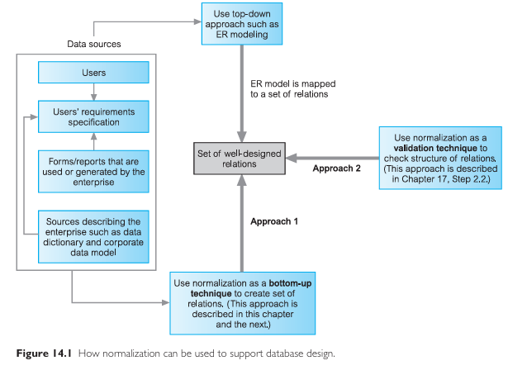

Slide 6
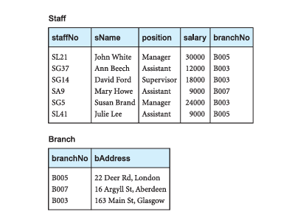

Slide 7
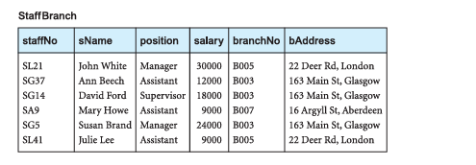

Slide 8
Insertion Anomalies
When adding a new staff member, branch details must also be entered, which can cause data inconsistency if entered incorrectly.
In a well-designed structure (separate Staff and Branch tables), only branchNo is added, avoiding duplication.
When adding a new branch with no staff, we must insert null values for staff attributes.
This is not allowed because staffNo is a primary key (cannot be null).
Proper design (separate relations) avoids this issue by:
Storing branch details independently
Adding staff information later when available

Slide 9
Deletion Anomalies
Deleting a staff tuple may remove important branch information.
Example: Deleting the last staff member of a branch results in the loss of that branch’s details from the database.
In a proper design (separate Staff and Branch tables):
Deleting staff data does not affect branch data
Branch details remain safe in the Branch relation
Separation of relations prevents unintended data loss

Slide 10
Modification Anomalies
Updating a branch detail (e.g., address) requires changing multiple tuples.
If not all tuples are updated then data inconsistency occurs (same branch shows different values).
Conclusion:
StaffBranch relation has update anomalies.
Splitting into Staff and Branch relations removes these issues.
Decomposition Properties:
Lossless-join property:
Original relation can be reconstructed from smaller relations.
Dependency preservation property:
Constraints can be enforced without joining tables.

Slide 11
Functional Dependencies
An important concept associated with normalization.
Describes the relationship between attributes in a relation.
Definition
If A and B are set of attributes of relation R,
B is functionally dependent on A (denoted as A → B),
if each value of A is associated with exactly one value of B.
e.g. CourseCode → CourseTitle, CreditHours
CourseTitle → CourseCode (×)
CourseTitle → CreditHours (×)
Functional dependency is a property of the meaning or semantics of the attributes in a relation.
The semantics indicate how attributes relate to one another.
Model → Make
Make → Model (×)

Slide 12
Functional Dependencies
When a FD is present, it is specified as a constraint between the attributes.
Consider a relation with set of attributes A and B, where B is functionally dependent on A.
E.g. A = {CourseCode} and B = {CourseTitle, CreditHours}
Thus, when two tuples have the same value of A, they also have the same value of B.
However, for a given value of B there may be several different values of A.

Slide 13

Functional Dependencies
The dependency between attributes A and B can be represented diagrammatically below.
An alternative way to describe the relationship between attributes A and B is to say
A functionally determines B
Determinant Refers to the attribute, or group of attributes, on the LHS of the arrow of a FD.
For example, in Fig 1 above, A is the determinant of B.
We demonstrate the identification of a functional dependency in the following example.
Fig 1

Slide 14
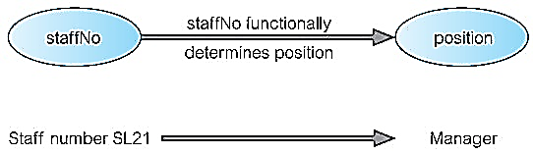
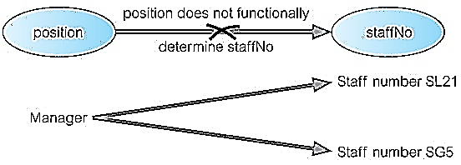
Example 1: Functional Dependency
Consider the attributes staffNo and position of the Staff relation in Fig 3.
For a specific staffNo, for example SL21, we can determine the position of that member of staff as Manager.
In other words, staffNo functionally determines position.
However, Fig 2(b) illustrates that the opposite is not true, as position does not functionally determine staffNo.
A member of staff holds one position; however, there may be several members of staff with the same position.
Fig 2 (a)
Fig 2 (b)

Slide 15
Example 1: Functional Dependency
In this example, staffNo is the determinant of this functional dependency.
The relationship between staffNo and position is one-to-one (1:1): for each staff number there is only one position.
On the other hand, the relationship between position and staffNo is one-to-many (1:*): there are several staff numbers associated with a given position.
For the purposes of normalization, we identify FDs between attributes of a relation
i.e. finding one-to-one relationship between attributes
attribute(s) on LHS of dependency make up the determinant
the attribute(s) on the RHS make up the dependent.

Slide 16
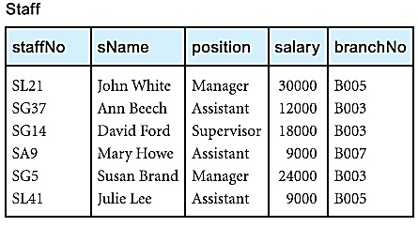
Example 2: Functional Dependency that holds for all time
A FD is a property of a relational schema (intension) and not a property of a particular instance of the schema (extension).
Consider the values shown in staffNo and sName attributes of the Staff relation in Fig 3.
We see that for a specific staffNo, for example SL21, the name of that member of staff as John White.
Furthermore, it appears that for a specific sName, for example, John White, the staff number for that member of staff as SL21.
Fig 3

Slide 17
Example 2: Functional Dependency that holds for all time
Can we therefore conclude that
the staffNo attribute functionally determines the sName attribute and/or
the sName attribute functionally determines the staffNo attribute?
If the values shown in the Staff relation of Fig 3 represent the set of all possible values for staffNo and sName attributes then the following FDs hold:
staffNo → sName
sName → staffNo
However we want to identify FDs that hold for all possible values for attributes of a relation.
For this, we should clearly understand the purpose of each attribute in that relation.

Slide 18
Example 2: Functional Dependency that holds for all time
For example, the purpose of staffNo attribute is to uniquely identify each member of staff, whereas the purpose sName attribute is to hold the names of members of staff.
Clearly, if we know the staff number (staffNo) of a member of staff, we can determine the name of the member of staff (sName).
However, as it is possible for the sName attribute to hold identical values for members of staff with the same name,
then for some members of staff we would not be able to determine their staff number (staffNo).

Slide 19
Example 2: Functional Dependency that holds for all time
The relationship between staffNo and sName is one-to-one (1:1).
On the other hand, the relationship between sName and staffNo is one-to-many (1:*).
The FD that remains true after consideration of all possible values for the staffNo and sName attributes of the Staff relation is:
staffNo → sName

Slide 20
Full Vs Partial dependency
Full functional dependency If A and B are set of attributes of a relation, B is fully functionally dependent on A if B is dependent on A, but not on any proper subset of A.
Partial functional dependency A functional dependency A → B is a partial dependency if there is some attribute that can be removed from A and yet the dependency still holds.
Consider the following FD that exists in the Staff relation
staffNo, sName → branchNo
It is correct to say that each value of (staffNo, sName) is associated with a single value of branchNo.

Slide 21
Full Vs Partial dependency
However, it is not a full functional dependency because branchNo is also functionally dependent on a proper subset of (staffNo, sName), namely staffNo.
In other words, the functional dependency shown above is an example of a partial dependency.
The type of FDs that we are interested in identifying is a full FD as shown below:-
staffNo → branchNo
AcctNum, CustID → AccessDate

Slide 22
Transitive Dependency
Transitive dependency is necessary to recognize because its existence in a relation can potentially cause different types of update anomalies.
Transitive Dependency Suppose A, B, and C are attributes of a relation such that
A → B and B → C,
then C is transitively dependent on A via B
Example Consider the following functional dependencies within the StaffBranch relation
staffNo → sName, position, salary, branchNo, bAddress
branchNo → bAddress
The transitive dependency staffNo → bAddress exists on staffNo via branchNo.

Slide 23
The Process of Normalization
Normalization is a formal technique for analyzing relations based on
their primary key (or candidate keys) and
functional dependencies (Codd, 1972b).
Normalization is often executed as a series of steps.
Each step corresponds to a specific normal form that has known properties.
Three normal forms were initially proposed called
First Normal Form (1NF),
Second Normal Form (2NF), and
Third Normal Form (3NF).
As normalization proceeds, the relations become progressively more restricted (stronger) in format and also less vulnerable to update anomalies.

Slide 24
The Process of Normalization
Subsequently, R. Boyce and E. F. Codd introduced a stronger definition of third normal form called Boyce–Codd Normal Form (BCNF) (Codd, 1974).
With the exception of 1NF, all these normal forms are based on functional dependencies among the attributes of a relation (Maier, 1983).
Higher normal forms that go beyond BCNF were introduced later such as Fourth Normal Form (4NF) and Fifth Normal Form (5NF) (Fagin, 1977, 1979).
However, these later normal forms deal with situations that are very rare.

Slide 25
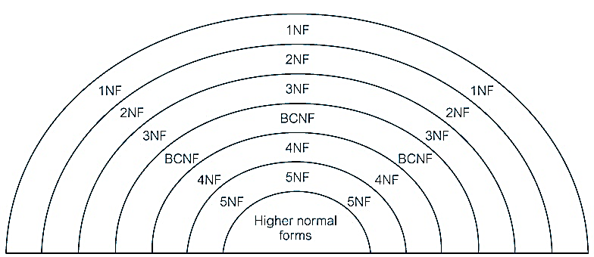
The Process of Normalization
For relational data model, it is only First Normal Form (1NF) that is critical in creating relations;
all subsequent normal forms are optional.
However, to avoid update anomalies, it is recommended to proceed to at least Third Normal Form (3NF).
Fig 4 illustrates the relationship between various normal forms.
It shows that
some 1NF relations are also in 2NF and
some 2NF relations are also in 3NF, and so on.
Fig 4

Slide 26
The Process of Normalization
User Views / sample forms
Second Normal Form (2NF)
Fig 5
Unnormalized Relations (UNF)
Remove Transitive dependencies on PK
Remove Repeating groups
Third Normal Form (3NF)
Normalized Relations (1NF)
Remove dependencies on other candidate keys
Remove Partial dependencies on PK
Boyce-Codd Normal Form (BCNF)

Slide 27
The Process of Normalization
In this lecture (and next), we describe normalization as a bottom-up technique
extracting information about attributes from sample forms that are first transformed into table format,
which is described as being in Unnormalized Form (UNF).
This table is then subjected progressively to the different requirements
associated with each normal form
until ultimately the attributes shown in the original sample forms are represented as a set of 3NF relations.
To simplify the description of normalization we assume that
a set of functional dependencies is given for each relation in the worked examples and
each relation has a designated primary key.

Slide 28
Unnormalized Form (UNF) First Normal Form (1NF)
Before discussing First Normal Form, we provide a definition of the state prior to First Normal Form.
Unnormalized Form (UNF) A table that contains one or more repeating groups.
First Normal Form (1NF) A relation in which the intersection of each row and column contains one and only one value.
We begin the process of normalization by first transferring the data from the source (for example, a standard data entry form) into table format with rows and columns.
We demonstrate this in the following worked example using the DreamHome case study.
A collection of (simplified) DreamHome leases shown in Fig 6.

Slide 29
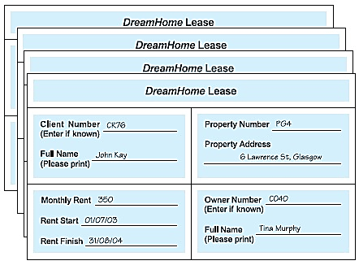
Example: First Normal Form (1NF)
The lease on top is for a client called John Kay who is leasing a property in Glasgow, which is owned by Tina Murphy.
For this worked example, we assume that
a client rents a given property only once and
cannot rent more than one property at any one time.
Sample data is taken from two leases for two different clients called John Kay and Aline Stewart and is transformed into table format with rows and columns, as shown in Fig 7.
Fig 6

Slide 30
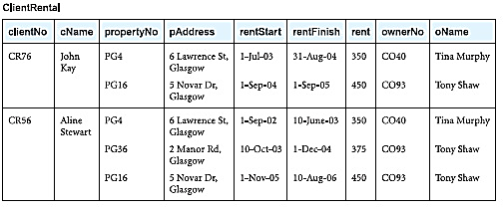
First Normal Form (1NF)
This table format is said to be in UnNormalized Form.
To transform the UNF to First Normal Form, we identify and remove repeating groups within the table.
A repeating group is
an attribute, or group of attributes, within a table
that occurs with multiple values for a single occurrence of the nominated key attribute(s) for that table.
In this context, key refers to the attribute(s) that uniquely identify each row within the unnormalized table.
Fig 7

Slide 31
First Normal Form (1NF)
We identify the key attribute for the ClientRental unnormalized table as clientNo.
Next, we identify the RG in the unnormalized table as the property rented details, which repeats for each client.
The structure of the repeating group is:
Repeating Group = (propertyNo, pAddress, rentStart, rentFinish, rent, ownerNo, oName)
As a consequence, there are multiple values at the intersection of certain rows and columns.

Slide 32
First Normal Form (1NF)
For example, there are two values for propertyNo (PG4 and PG16) for the client named John Kay.
One of the approaches to removing repeating groups from unnormalized tables
by filling in the blanks by duplicating the nonrepeating data, where required.
This approach commonly referred to as ‘flattening’ the table.
We remove the repeating group (property rented details) by entering the appropriate client data into each row.

Slide 33
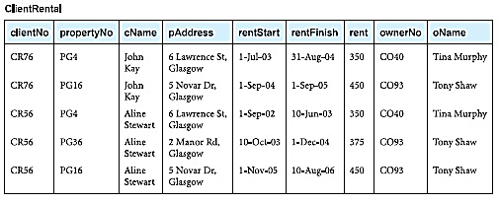
First Normal Form (1NF)
The resulting tables are now referred to as 1NF relations containing atomic (or single) values at the intersection of each row and column.
The resulting 1NF ClientRental relation is shown in Fig 8.
Based on given assumptions, we identify the candidate keys for the ClientRental relation as being composite keys comprising
(clientNo, propertyNo),
(clientNo, rentStart), and
(propertyNo, rentStart).
Fig 8

Slide 34
First Normal Form (1NF)
We select (clientNo, propertyNo) as the primary key for the relation.
The ClientRental relation is defined as follows:
ClientRental (clientNo, propertyNo, cName, pAddress, rentStart, rentFinish, rent, ownerNo, oName)
This relation is in 1NF as there is a single value at the intersection of each row and column.
It contains data describing clients, property rented, and property owners, which is repeated several times.
As a result, the ClientRental relation contains significant data redundancy.
If implemented, this 1NF relation would be subject to the update anomalies.

Slide 35
First Normal Form (1NF)
The 1NF ClientRental relation has following update anomalies.
Insertion Anomaly: When we want to add a new property for rent in the ClientRental relation in Fig 8, a dummy clientNo need to be assigned to that tuple because it is part of PK.
Deletion Anomaly: Suppose a particular owner doesn’t want to offer his or her property for rent anymore so the property record needs to be removed. However along with that, all the client and other records would have to be removed.
Modification Anomaly: Suppose we wish to change the rent of property number PG4. We have to update two tuples in the ClientRental relation. If only one tuple is updated, this results in an inconsistency in the database.

Slide 36
Second Normal Form (2NF)
To remove some of these anomalies, we must transform the relation into Second Normal Form.
Second Normal Form (2NF) is based on the concept of full functional dependency.
Second Normal Form applies to relations with composite PKs, that is, relations with a primary key composed of two or more attributes.
A relation with a single-attribute primary key is automatically in at least 2NF.
Second Normal Form (2NF) A relation that is in First Normal Form and every non-primary-key attribute is fully functionally dependent on the primary key.

Slide 37
Second Normal Form (2NF)
The normalization of 1NF relations to 2NF involves the removal of partial dependencies.
The ClientRental relation has the following full and partial functional dependencies on PK:-
fd1: clientNo, propertyNo → rentStart, rentFinish (full dependency on primary key)
fd2: clientNo → cName (Partial dependency)
fd3: propertyNo → pAddress, rent, ownerNo, oName (Partial dependency)

Slide 38
Second Normal Form (2NF)
The identification of partial dependencies within the ClientRental relation indicates that the relation is not in 2NF.
To transform the ClientRental relation into 2NF requires the creation of new relations
we remove the partially dependent attribute(s) from the relation by placing them in a new relation
along with a copy of their determinant.
This results in the creation of three new relations called Client, Rental, and PropertyOwner, as shown in Fig 9.
These three relations are in 2NF as every non-PK attribute is fully functionally dependent on the PK of the relation.

Slide 39
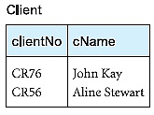
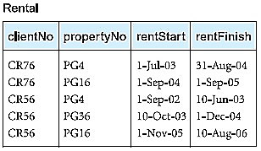
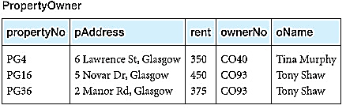
Second Normal Form (2NF)
The relations have the following form:
Client (clientNo, cName)
Rental (clientNo, propertyNo, rentStart, rentFinish)
PropertyOwner (propertyNo, pAddress, rent, ownerNo, oName)
Fig 9

Slide 40
Third Normal Form (3NF)
Although 2NF relations have less redundancy than those in 1NF, they may still suffer from update anomalies.
For example, if we want to update the name of an owner, such as Tony Shaw (ownerNo CO93), we have to update two tuples in the PropertyOwner relation of Fig 9.
If we update only one tuple and not the other, the database would be in an inconsistent state.
This update anomaly is caused by a transitive dependency.
Fd4: ownerNo → oName (Transitive dependency on PK)
We need to remove such dependencies by progressing to Third Normal Form.

Slide 41
Third Normal Form (3NF)
Third Normal Form (3NF) A relation that is in First and Second Normal Form and in which no non-primary-key attribute is transitively dependent on the primary key.
The normalization of 2NF relations to 3NF involves the removal of transitive dependencies.
We remove the transitively dependent attribute(s) from the relation by placing the attribute(s) in a new relation along with a copy of the determinant.
All the non-PK attributes within the PropertyOwner relation are functionally dependent on the PK,
with the exception of oName, which is transitively dependent on propertyNo via ownerNo (represented as fd4).

Slide 42
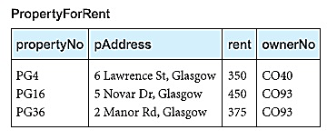
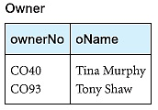
Third Normal Form (3NF)
To transform the PropertyOwner relation into 3NF we must first remove this transitive dependency by creating two new relations called PropertyForRent and Owner, as shown in Figure 10.
The new relations have the form:
PropertyForRent (propertyNo, pAddress, rent, ownerNo)
Owner (ownerNo, oName)
Fig 10

Slide 43
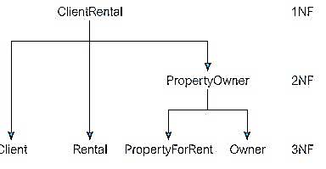
Third Normal Form (3NF)
The PropertyForRent and Owner relations are in 3NF as there are no further transitive dependencies on the PK.
The ClientRental relation shown in Fig 8 has been transformed by the process of normalization into four relations in 3NF.
Fig 11 illustrates the process by which the original 1NF relation is decomposed into the 3NF relations.
Fig 11

Slide 44
Third Normal Form (3NF)
The resulting 3NF relations have the form:
Client (clientNo, cName)
Rental (clientNo, propertyNo, rentStart, rentFinish)
PropertyForRent (propertyNo, pAddress, rent, ownerNo)
Owner (ownerNo, oName)
The original ClientRental relation shown in Figu 8 can be recreated by joining the Client, Rental, PropertyForRent, and Owner relations through the primary key/foreign key mechanism.
For example, the ownerNo attribute is a PK within the Owner relation and is also present within the PropertyForRent relation as a FK.
The clientNo attribute is a PK of the Client relation and is also present within the Rental relation as a FK.
Similarly, the propertyNo attribute is the PK of the PropertyForRent relation and is also present within the Rental relation acting both as a FK and as part of the PK for this relation.

